Slide 1
Epidemiology of The Novel Coronavirus responsible for COVID-19* AKA SARS-CoV-2^{ð}

Slide 2
What’s in a Name?

Slide 3
Outline

Slide 4
Early Outbreak Reports

Slide 5
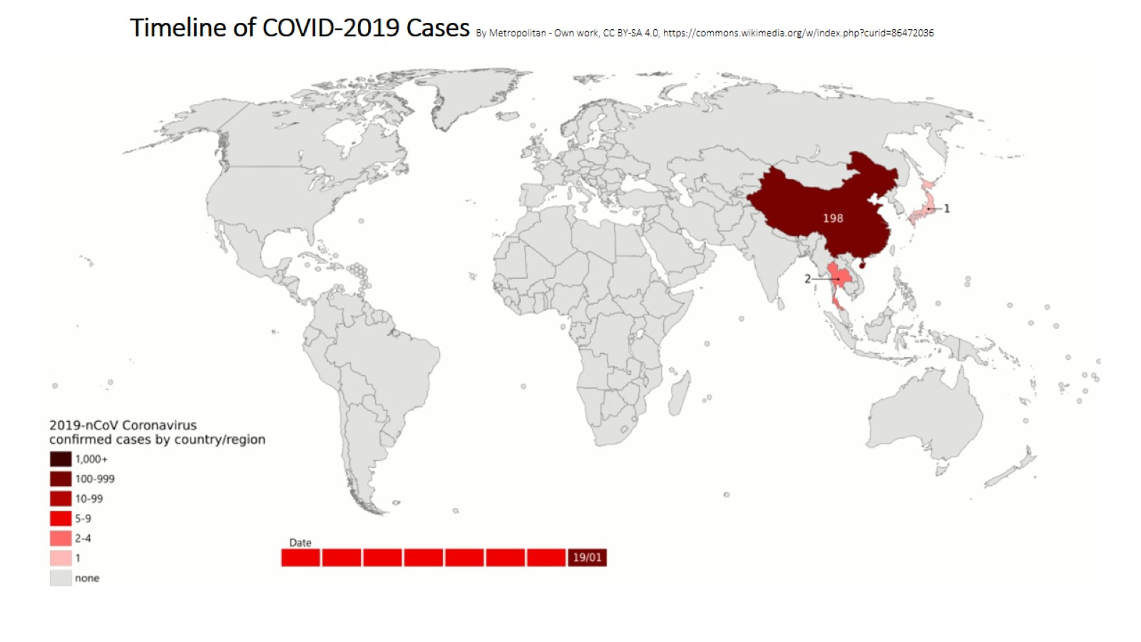
Timeline of COVID-2019 Cases By Metropolitan - Own work, CC BY-SA 4.0, https://commons.wikimedia.org/w/index.php?curid=86472036

Slide 6
Epidemiologic Curve of COVID-19 Outbreak

Slide 7
Current Figures (15 Feb 2020)

Slide 8
Chains of Transmission outside of China

Slide 9
Modelling Spread: Jan 29. Chinnazzi et al

Slide 10
General Presentation of COVID-19

Slide 11
Case Definitions: Suspected Case

Slide 12
Case Definitions: Probable Case

Slide 13
Case Definitions: Confirmed Case

Slide 14
Key Epidemiologic Features

Slide 15
Asymptomatic Spread?? :-O

Slide 16
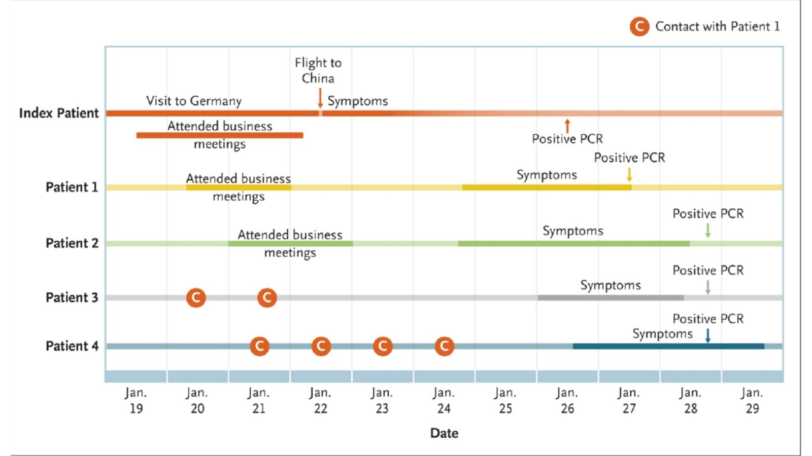
Transmission during incubation period?

Slide 17
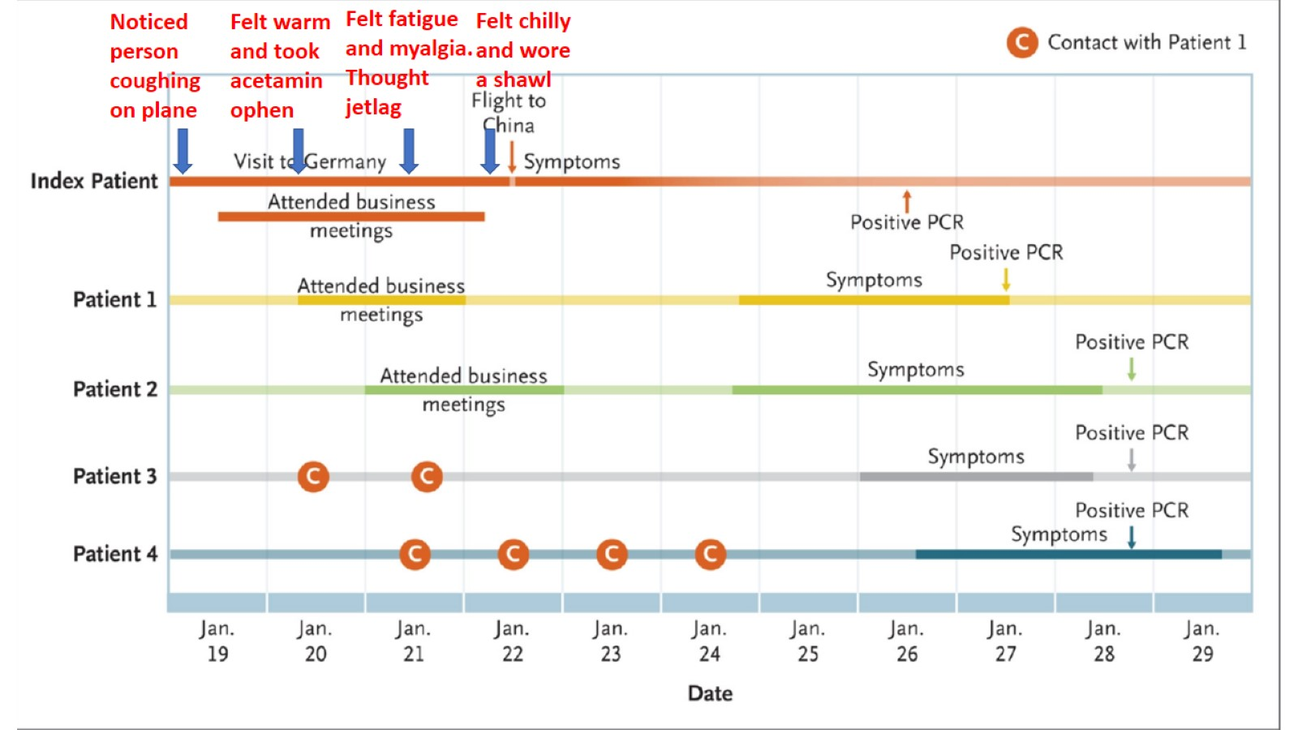
Transmission during incubation period?

Slide 18
So how IS it spread?

Slide 20
Fate of Droplets

Slide 21
Droplet transmission

Slide 22
Epidemiologic Containment Measures

Slide 23
Fever and Respiratory Symptoms

Slide 24
Severe Acute Respiratory Illness Surveillance

Slide 25
NP Swab collection procedure (abridged)

Slide 26
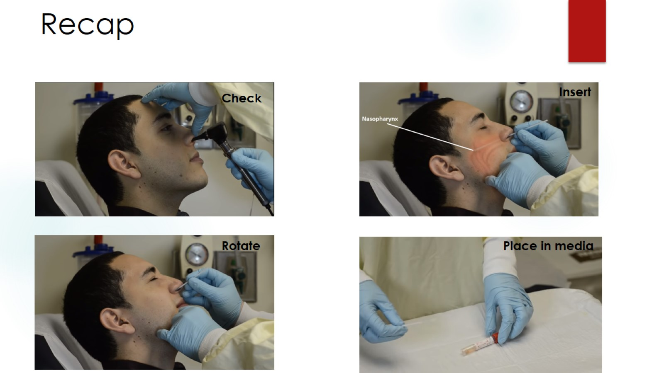
Recap

Slide 27
Quick Recap of IPC Measures

Slide 28
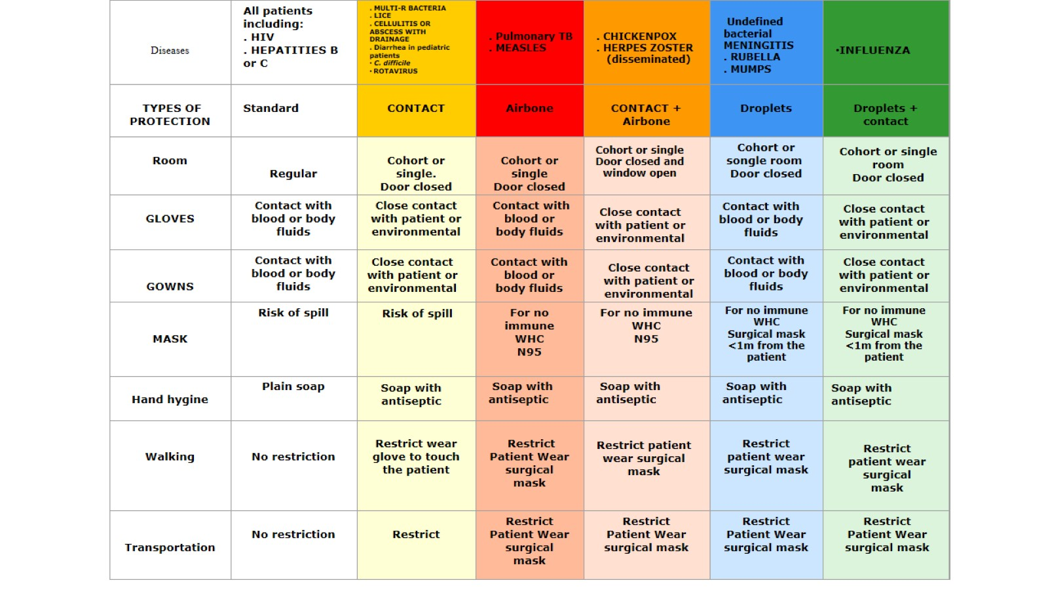

Slide 29
Wider public health measures?

Slide 30
Questions/Comments

